Slide 1
CACE
Community Action in the Climate Emergency

Slide 2
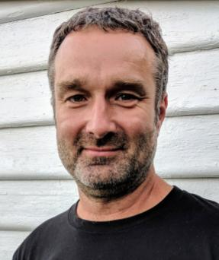
Adrian Whitehead

Slide 3
Personal Background
Environmental campaigner since is was 16
Key campaigner in creating the Otway Greater National Park
Stopped the Nass Valley dam in the ACT
Founded Beyond Zero Emissions
Founded Vote Climate
Founded Save the Planet

Slide 4
How bad is it?

Slide 5
Some analogues

Slide 6
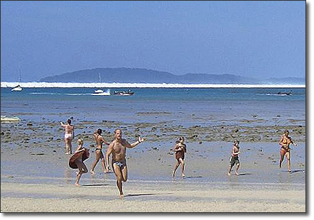

Slide 7
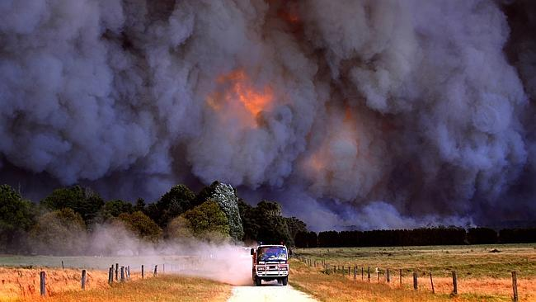

Slide 8
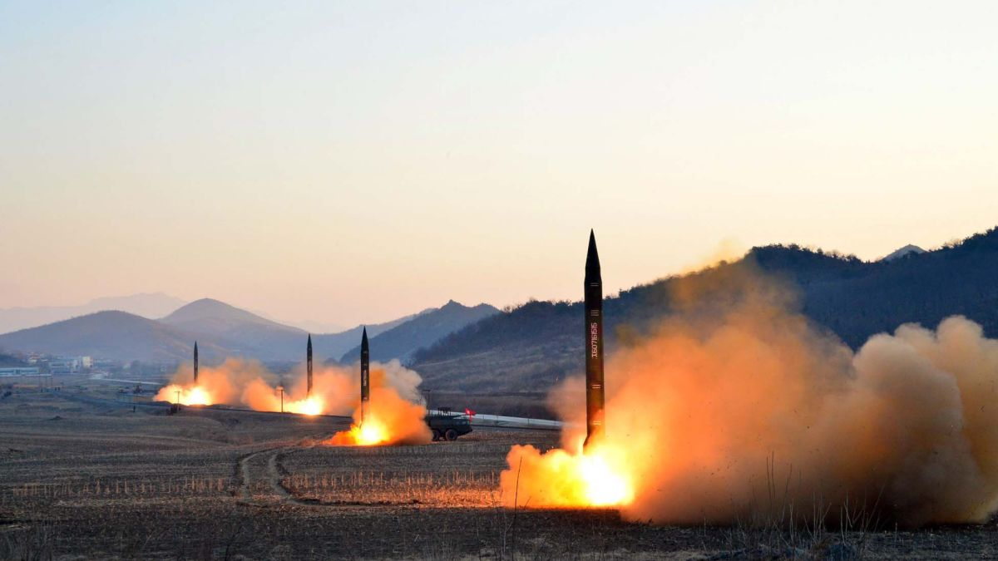

Slide 9
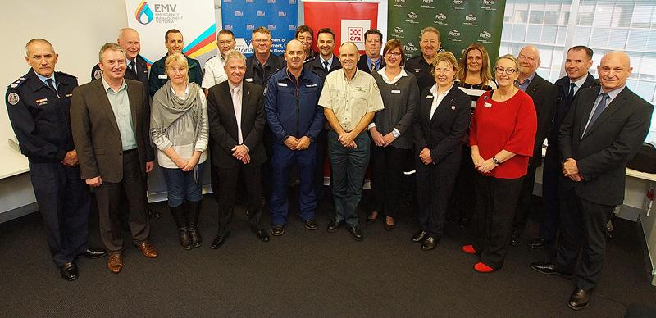
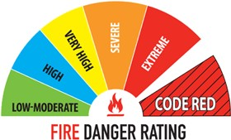
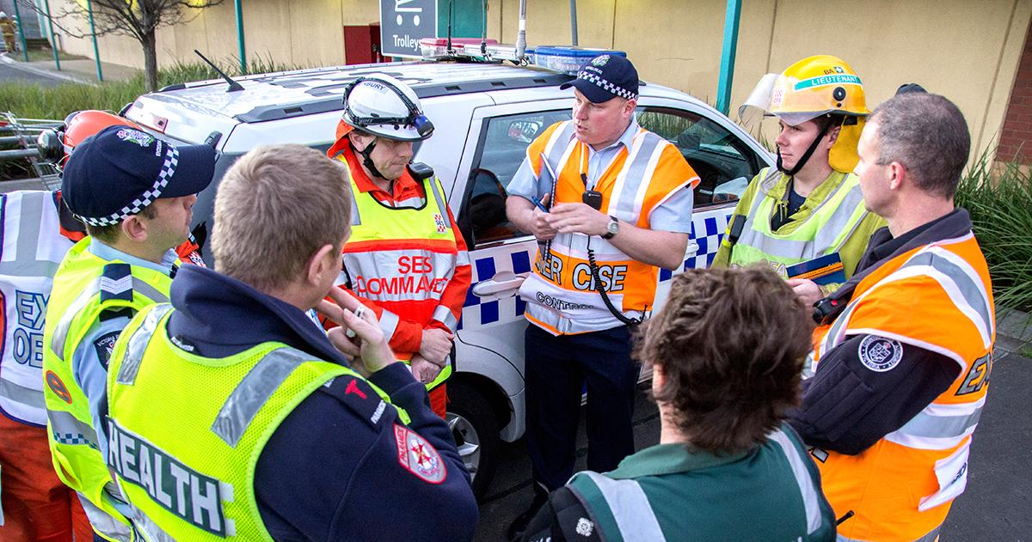
If it is an emergency
Notes:
We prepare for fire / flood emergencies for years ahead. Picture top: service and departmental heads meet to coordinate prevention, response and recovery efforts. Picture 2:

Slide 10
So… how bad is it?

Slide 13
“International agreements talk of limiting global warming to 1.5–2 degrees Celsius (°C), but in reality they set the world on a path of 3–5°C of warming.“
What Lies Beneath 2018 - Breakthrough

Slide 15
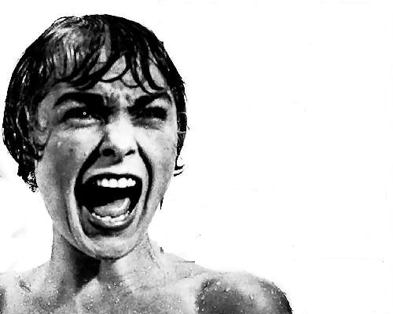
The “oh shit” moment

Slide 16
Why are we here?

Slide 17
Many reasons
Humans’ normalising change
Key systems still in place (for most)
Carbon Corporate influence
The Science
Complexity
Scale
Understanding of risk
Leadership

Slide 18
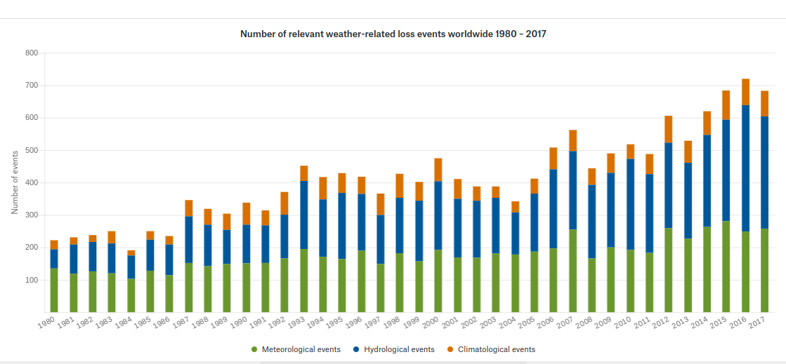
https://natcatservice.munichre.com/
Notes:
Increasing climate related events

Slide 19
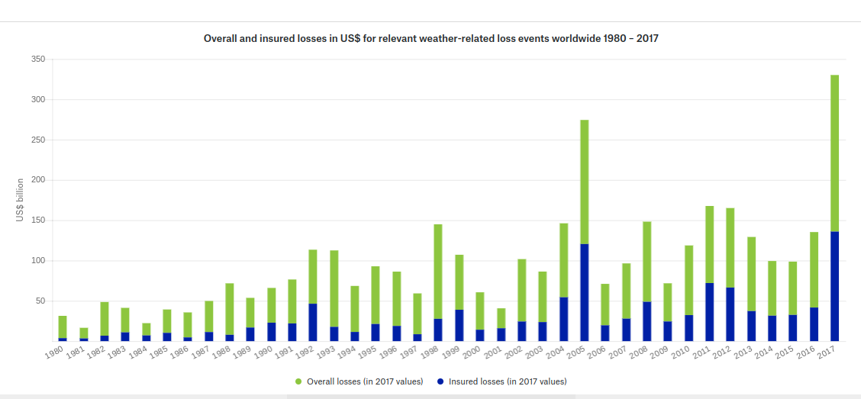
https://natcatservice.munichre.com/
Notes:
Increasing costs

Slide 20
I love a sunburnt country A land of sweeping plains Of ragged mountain ranges Of droughts and flooding rains
Notes:
Australia’s natural climate variability and extreme weather mask changes from global warming.

Slide 21
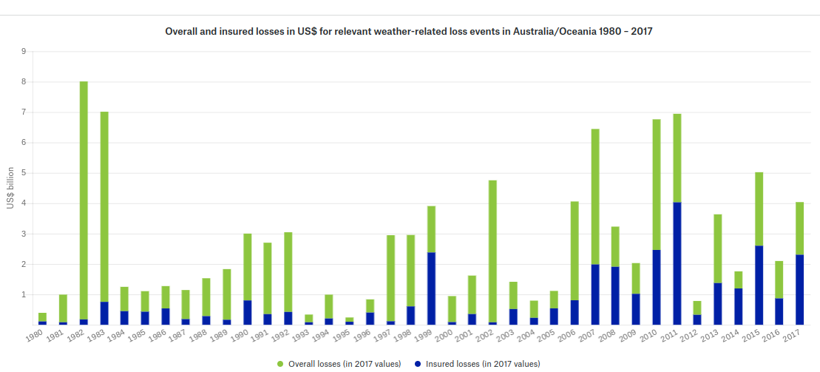
https://natcatservice.munichre.com/
Notes:
Past events have been more costly (corrected to today’s values)

Slide 22
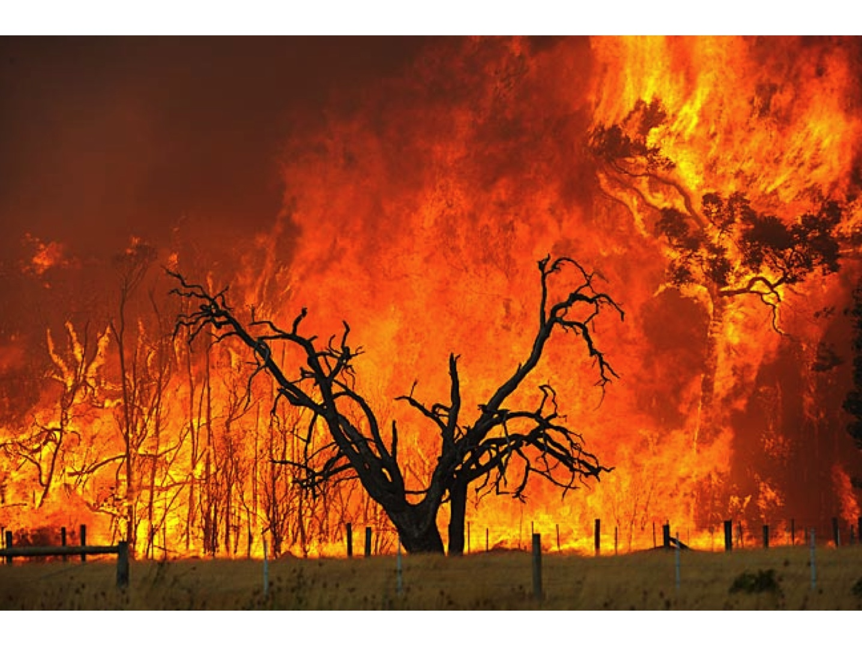
Notes:
Some people have experienced global warming first hand

Slide 23
Notes:
But most can keep living life as normal

Slide 24
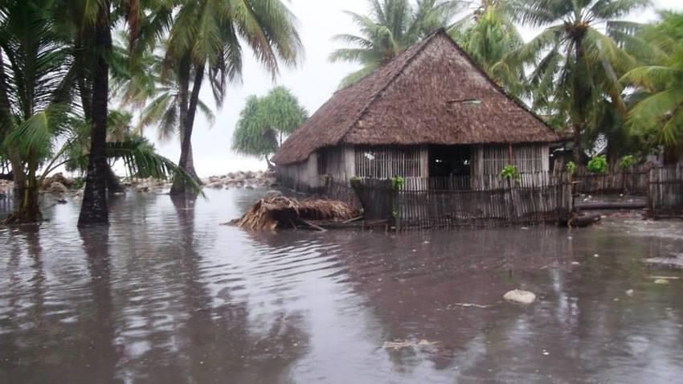

Slide 25
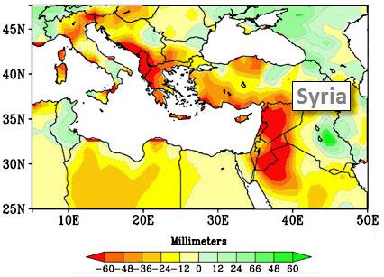
Notes:
Syria drought trigger war pushing existing political and religious tensions into rebellion and revolution.

Slide 26
The Science

Slide 27
The base science used to guide the worlds response is underestimating the problem

Slide 28
IPCC has some issues
Future projections optimistic
No soil emissions
No methane from wetlands
No loss of forest carbon sinks
No methane from permafrost melting
Offers as acceptable courses of actions failure to catastrophe at 50% or 33%
Underestimates climate sensitivity
Politically influenced
Culturally conservative
What Lies Beneath 2018 Breakthrough

Slide 29
Notes:
Get this new publication from breakthrough if you want more information.

Slide 30
Risk?

Slide 31
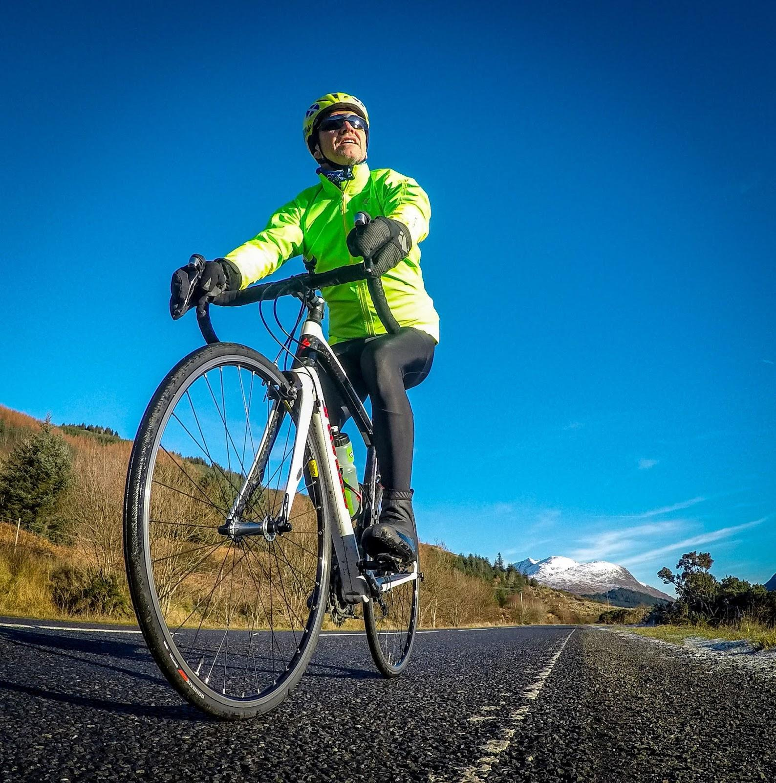
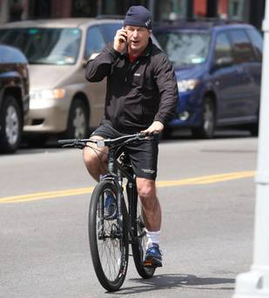
Risk
Notes:
How to ride a bike how not to ride a bike even if you are Alec Baldwin

Slide 32
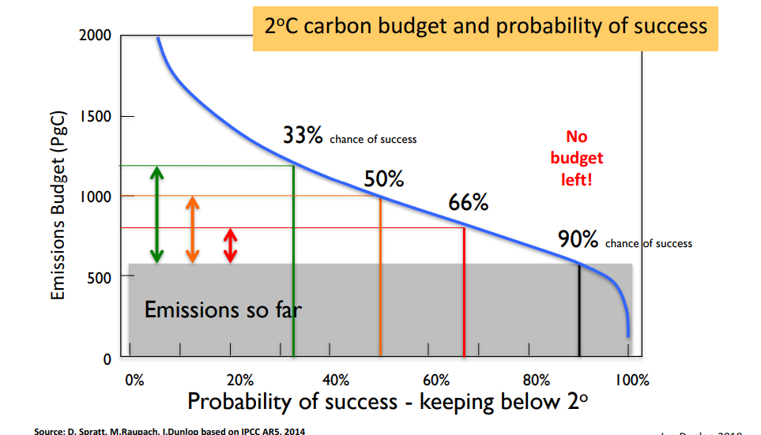
Risk
Notes:
We have no budget for acceptable risk

Slide 33
33%
50%
Notes:
IPCC thinks these probabilities are ok

Slide 35
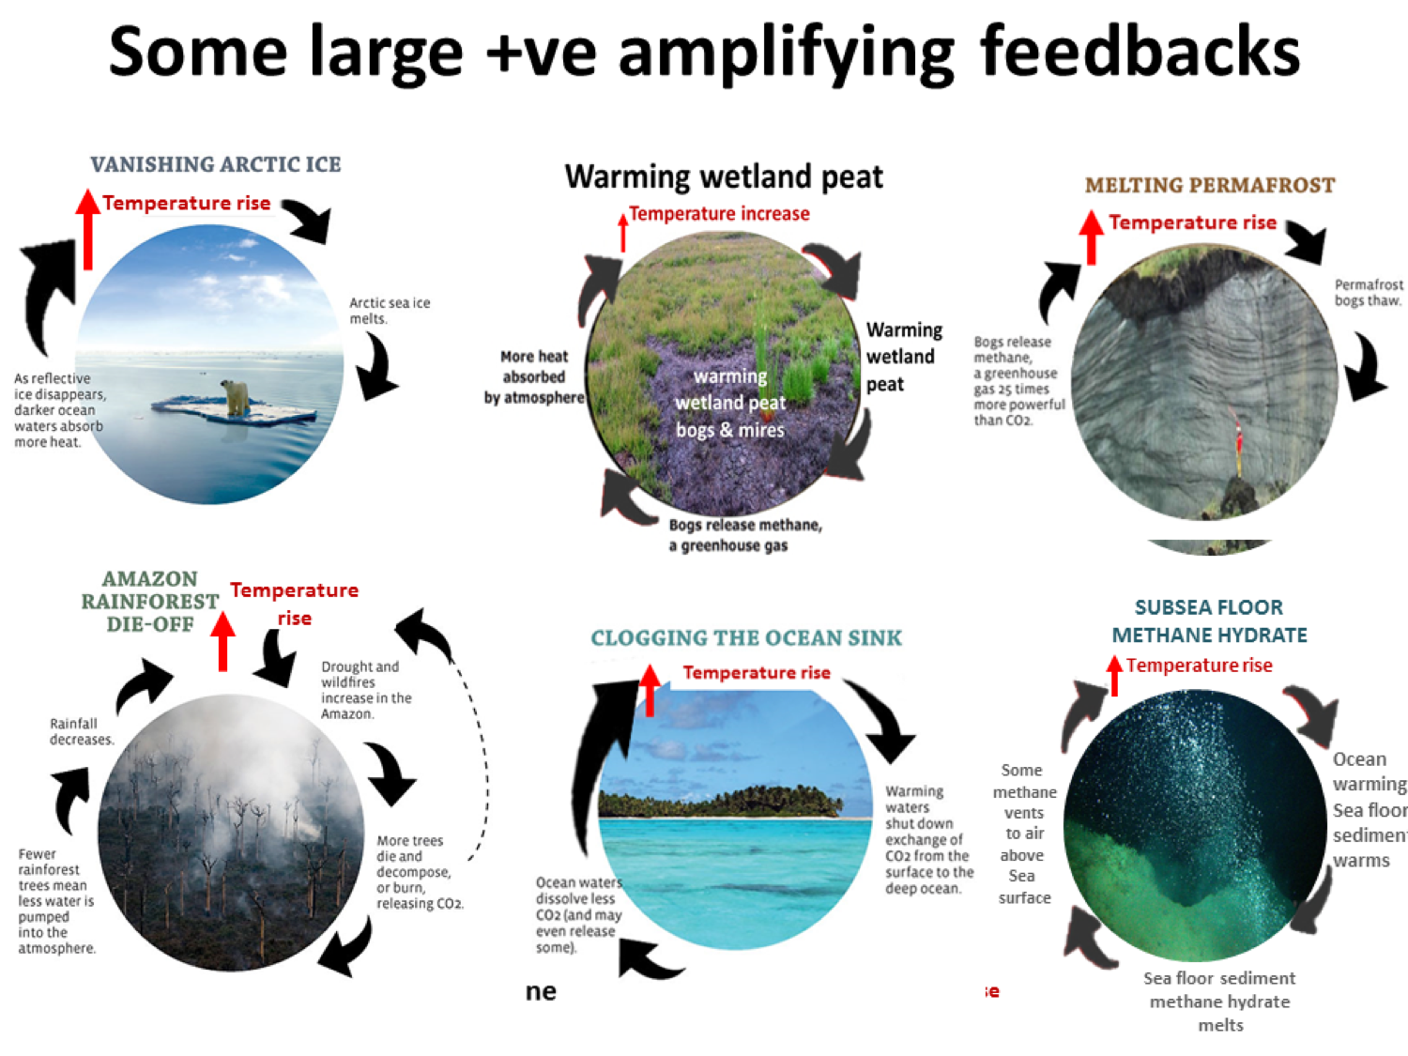
Notes:
Remember IPCC hasn't taken into account feedback loops

Slide 37
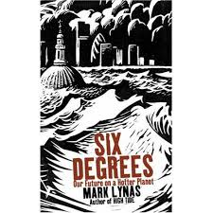
Notes:
Read this if you want to understand what each degree of warming means.

Slide 38
Cooling the globe is our only option. Why?

Slide 39
Warming for current greenhouse gases
Aerosols*: temporary (~1 week) cooling ~ 0.8-1°C from aerosols released from burning fossil fuels and other sources.
Hansen et al (2011), Atmos Chem Phys 11:13421-13449
485ppm
-0.8°C
Other GHG inc. methane
Aerosol cooling
2.4ºC of warming* at equilibrium
-0.6°C
400ppm
Inertia
Thermal inertia: delay in response of ~0.5-0.6°C as oceans heat up (like oven):
1/3rd immediately;
2/3^{rds} by 30 years;
All in 100 years.
Carbon dioxide
1.05°C
Realised warming
275 ppm
0°C
Pre- industrial
Pre- industrial
* Aerosols include black-carbon soot, organic carbon, sulphates, nitrates, as well as dust from smoke, manufacturing, windstorms, and other sources.
* For climate sensitivity of 3ºC
Notes:
We are already too hot.

Slide 41
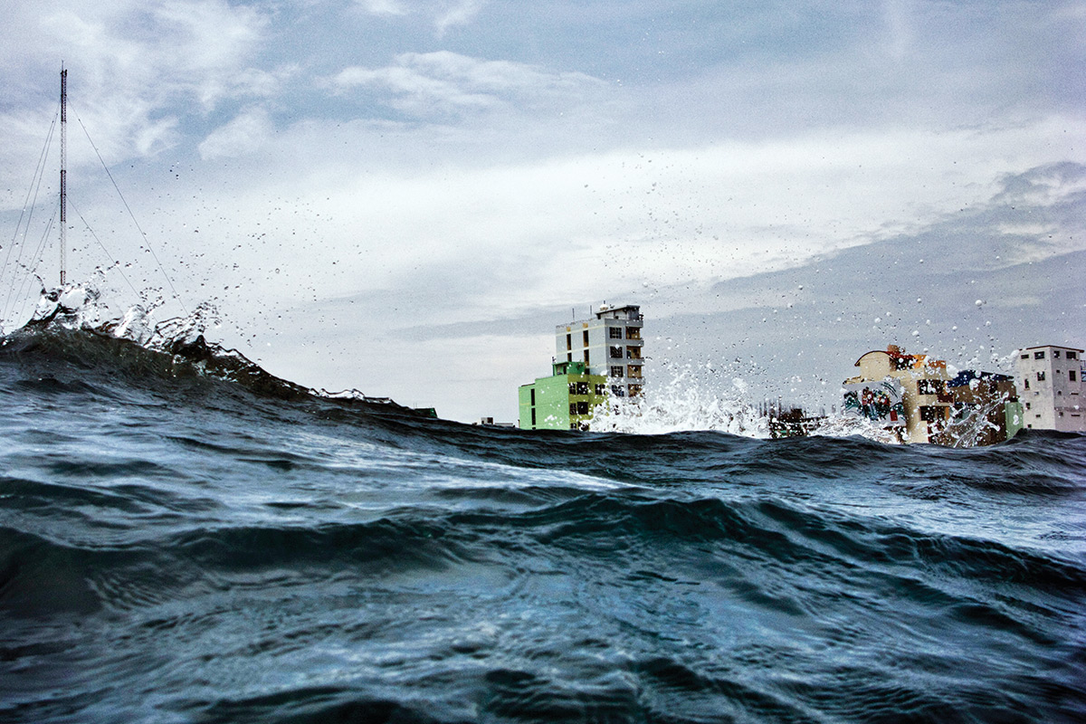
What will impact be on sea levels?
Sea level (metres)
Oligocene: 30 million years ago
• 3.5 degrees warmer
• sea levels 70 metres higher
+100
+50
–50
–100
–150
“Even if we would curb all CO2 emissions today, and stabilise at the modern level, then our natural relationship suggests that sea level would continue to rise to about 25 metres above the present.”
– Professor Eelco Rohling - Prof & Snr Fellow, ANU
Temperature C
Mid-Pliocene: 3 million years ago
• <1 degree warmer
• 25 metres higher
–10
–5
+5
20,000 years ago
• 6 degrees cooler
• 120 metres lower
Each 1C rise will in the long run increase sea-levels by 15–20 metres
Notes:
For example sea level rise alone is catastrophic

Slide 42
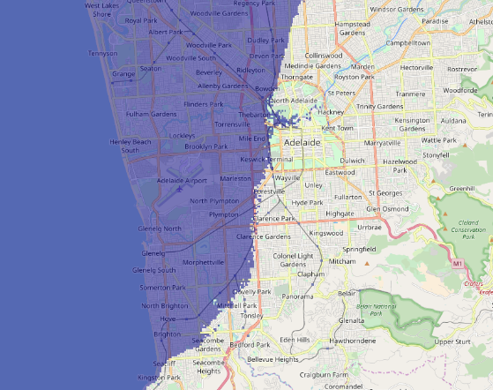
Notes:
Adeliage under 25m sealevel rise

Slide 43
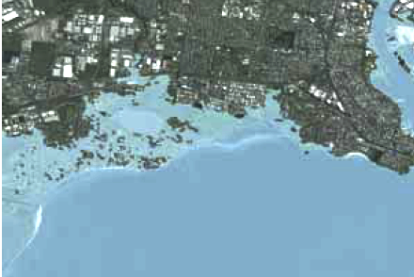
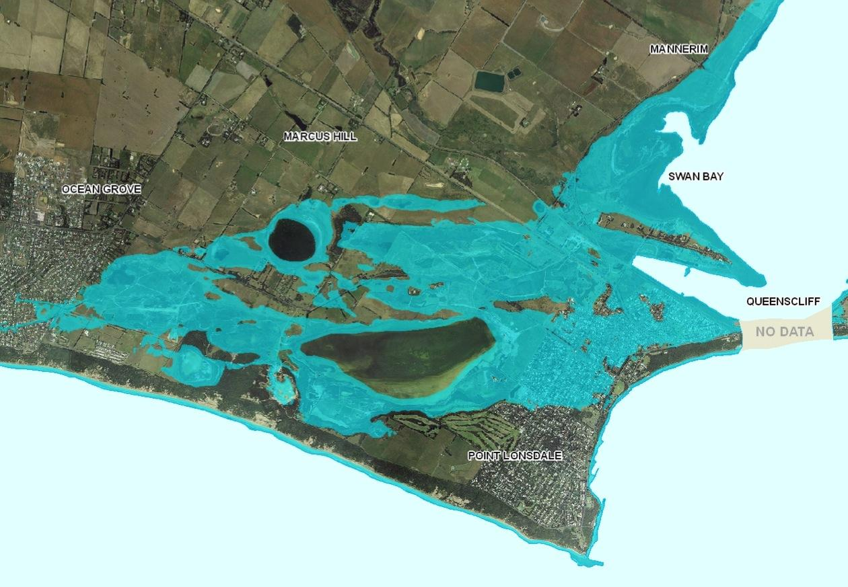
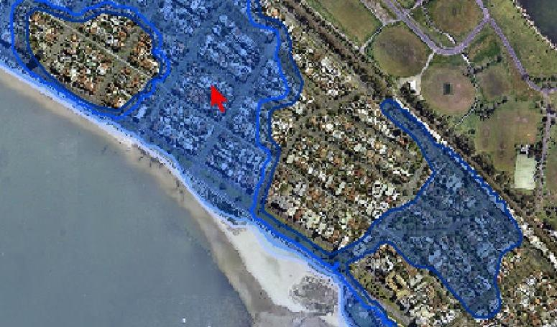
1.1 m. sea-level rise plus storm surge (to 2m)
Altona
Bellarine
Albert Park
Notes:
Part so Melbourne

Slide 44
Need to start making value based decisions

Slide 45
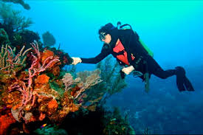
Notes:
Whose been to the GBR? How would like their kids to be able to go?

Slide 46
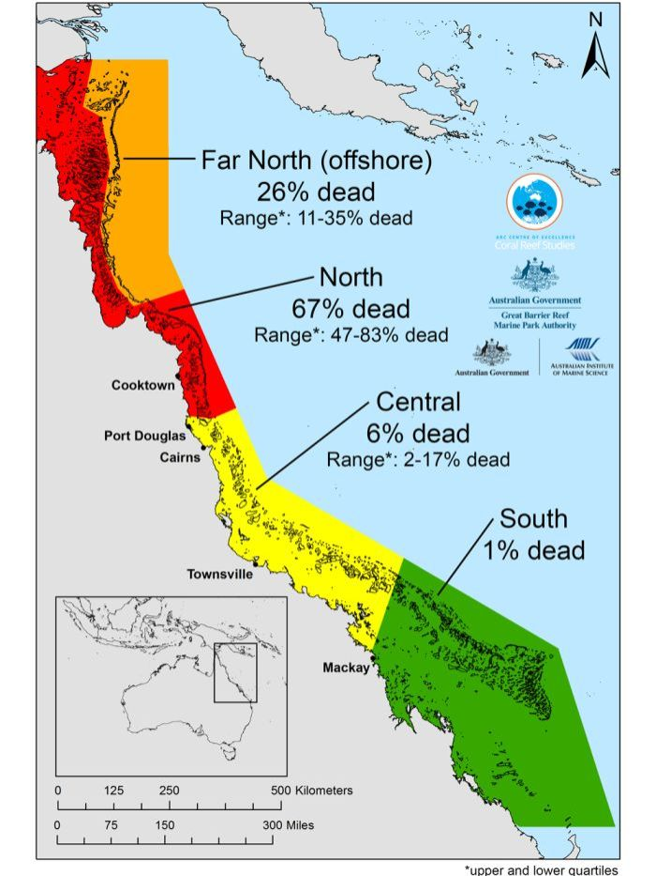

Slide 47
Do we want to save the Reef?

Slide 48
Test: Does this goal save the Reef?
Net negative Australian greenhouse gas emissions by 2040.
?
Notes:
No (its the Greens policy as May 2018)

Slide 49
Notes:
These guys seem pretty nice but I dont know them.

Slide 50
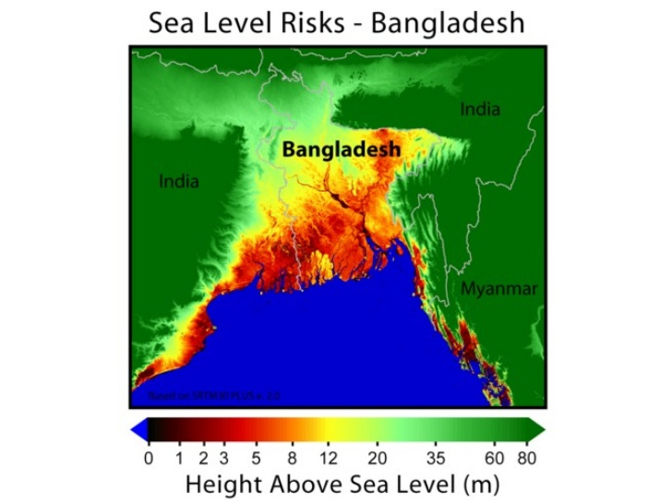
Notes:
Current warming sinkx this country.

Slide 51
Do we want to save the Bangladeshis?

Slide 52
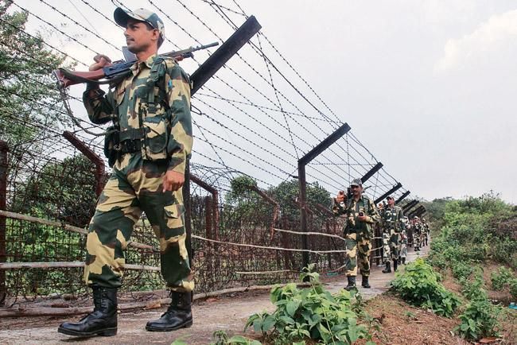
Notes:
India will kill them at their border wall.

Slide 53
Can we do it?

Slide 55
Yes?

Slide 56
We have the technical solutions

Slide 57
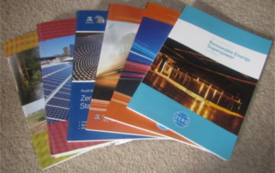
Solutions
We already have
100% renewables energy - YES
Buildings energy efficient power producing building - YES
Zero Emissions Surface Transport - YES
Negative Emission Agriculture - YES
Low EmIssion Concrete - YES
Drawdown - YES
Still to come
Zero Emissions Flight
Negative Emission Concrete

Slide 58
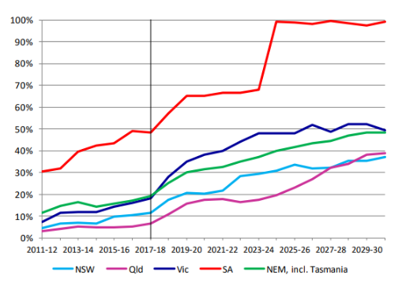
Solutions
Notes:
SA is going 100% renewable even if they don’t want to.

Slide 59
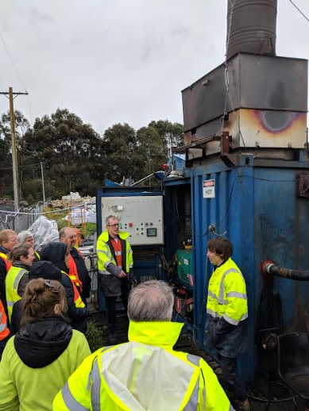
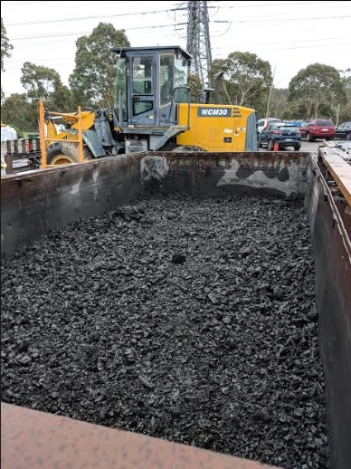
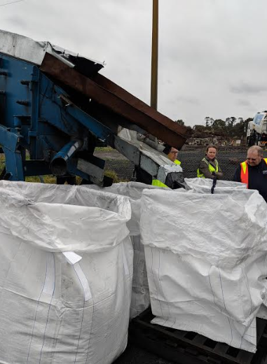
Solutions - Drawdown
Notes:
Biochar gives councils real options to help draw down by using waste organics to make stable charcoal.

Slide 60
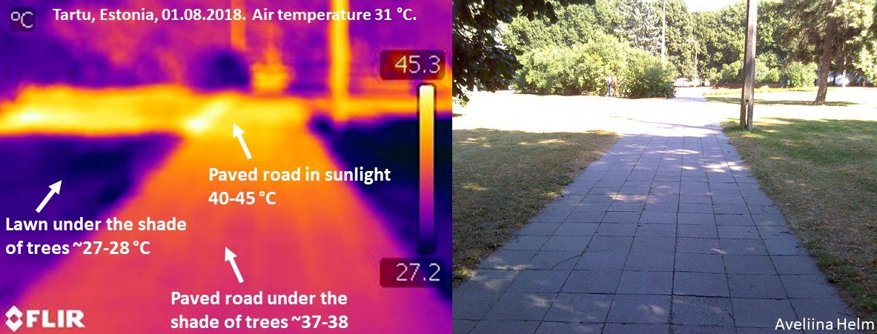
Solutions - Resilience
Notes:
Helping people to survive heatwaves is a council role.

Slide 61
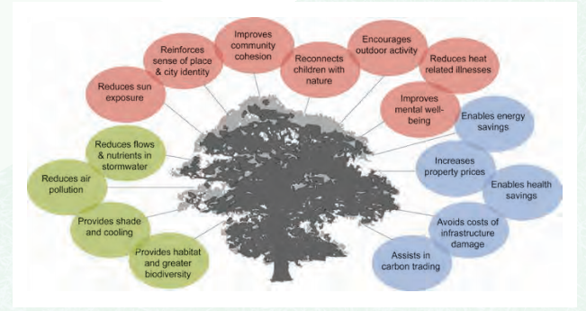
Solutions
Notes:
Lots of other benefits can flow from one positive action

Slide 62
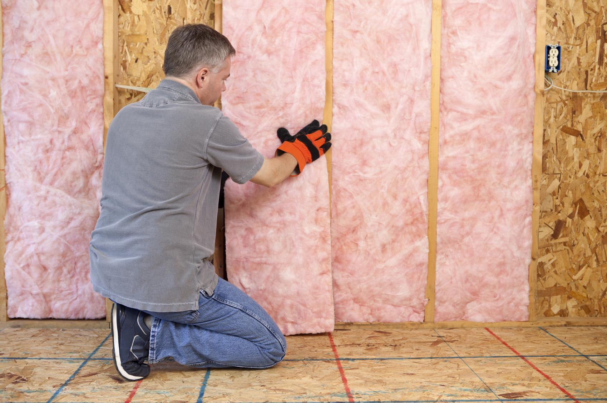
Solutions
Notes:
Retrofitting the homes of low income people can reduce health costs and improve quality of life will reducing energy consumption and saving money.

Slide 63
We just lack the leadership

Slide 64
Until Now

Slide 65
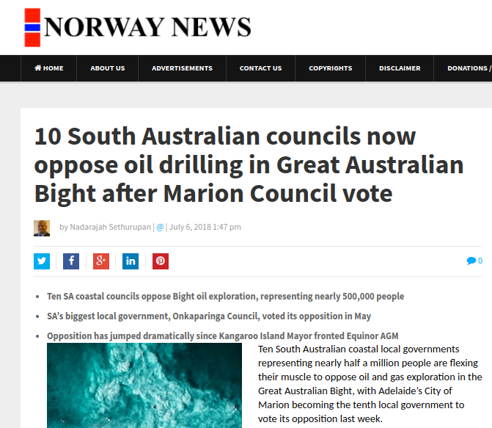
Notes:
Councils can make a difference.

Slide 66
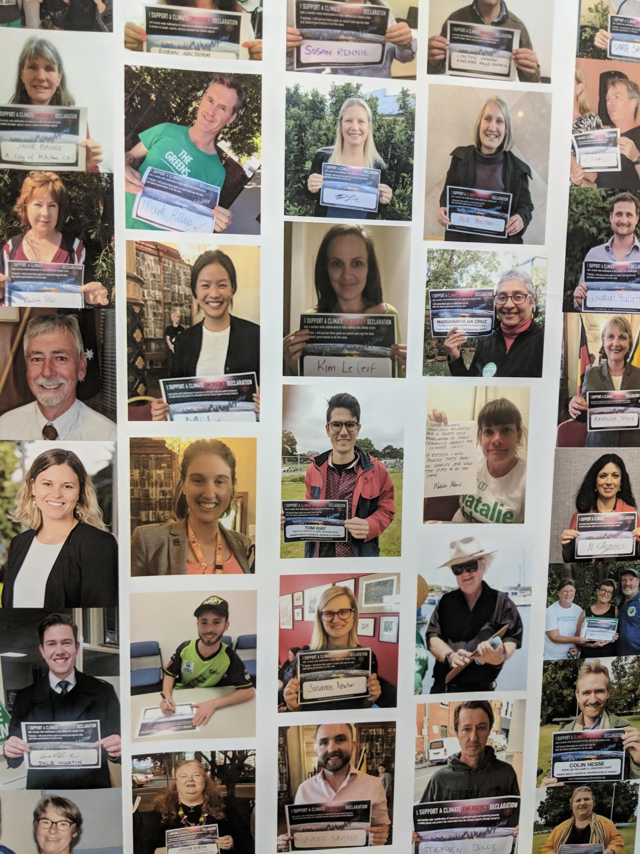
Notes:
Join the sitting councillor and mayors who are promising to declare a climate emergency.

Slide 67
Notes:
OUr goal is to return to a safe climate.

Slide 68
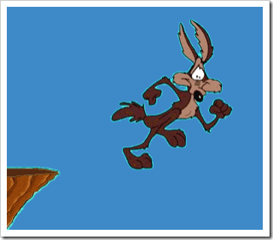
Notes:
Let’s get back to the cliff...

Slide 69
CACE
www.CACEonline.org

